Slide 1





Griha Software Technologies Pvt. Ltd.
Software Updates Review from Apr-2025 To Sep-2025

Slide 2

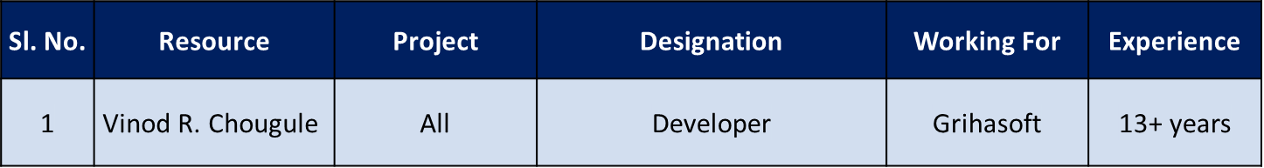
Summary
Resources
Accomplishment
Delivered new “QC Item - on screen edit” module in GOP application and it is developed using 3-tier architecture.
Development of “GAT” module in GOP application is in progress
Delivered 19 enhancements from GRIDS and 44 enhancements from GOP
Resolved 2 bugs from GRIDS and 5 from GOP
Served 26 data manipulation requirements from GRIDS and 19 from GOP
Griha Software Technologies Pvt. Ltd.
ISO 9001 : 2015 And
ISO 27001 : 2013 Certified Company
@2003-2017
@2003-2025
@2003-2020

Slide 3
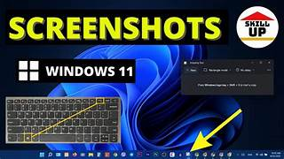
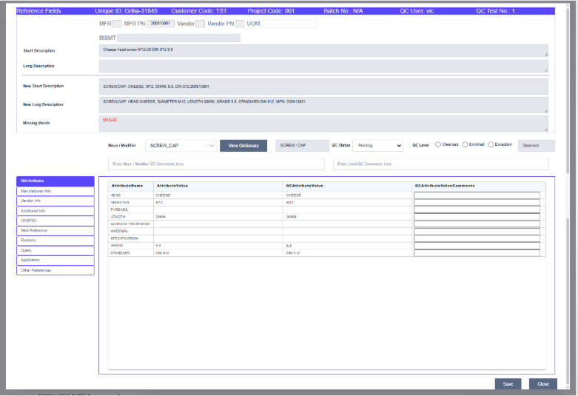
QC Item Edit Screen - GOP
ISO 9001 : 2015 And
ISO 27001 : 2013 Certified Company
@2003-2025
@2003-2021

Slide 4
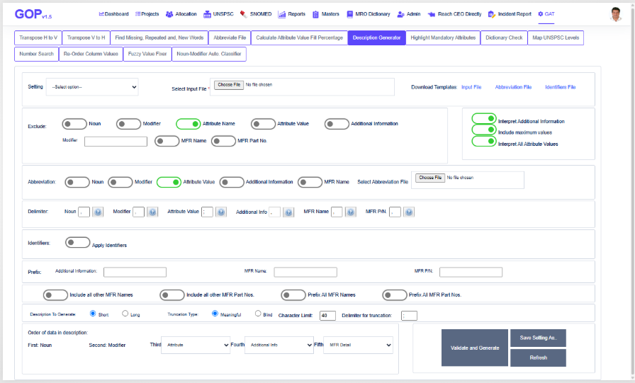
GAT Functions - GOP
ISO 9001 : 2015 And
ISO 27001 : 2013 Certified Company
@2003-2025
@2003-2021

Slide 5
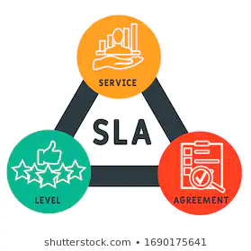
Software SLA
  Schedule Adherence : To remain 90% and above for all planned delivery activities. Report on Planned duration versus Actual duration for a given requirement’s delivery is recorded and Analysed
  GRIDS - Enhancements
  GOP - Enhancements
Month | Planned Tasks | Completed Tasks | Completion (%)
Apr-25 | 5 | 5 | 100
May-25 | 5 | 5 | 100
Jun-25 | 2 | 2 | 100
Jul-25 | 0 | 0 | 0
Aug-25 | 7 | 7 | 100
Sep-25 | 0 | 0 | 0
Month | Planned Tasks | Completed Tasks | Completion (%)
Apr-25 | 7 | 7 | 100
May-25 | 4 | 4 | 100
Jun-25 | 14 | 14 | 100
Jul-25 | 8 | 8 | 100
Aug-25 | 6 | 6 | 100
Sep-25 | 5 | 5 | 100
Total GRIDS Enhancements : 19
Total GOP Enhancements : 44
ISO 9001 : 2015 And
ISO 27001 : 2013 Certified Company
@2003-2025
@2003-2021

Slide 6
Software SLA
Fault Slip Through :
  No. of incidences has to be below 10 during the beta testing time
S.No. | Description | Reported On | Resolved On | Project
1 | "QC Item Details Edit Screen" is showing the message "Please select the level" even after selecting the QC level. Please check it. | 04-Jun-25 | 05-Jun-25 | GOP – QC
2 | Not able to select "Level" option from the "Production Edit item screen". After selecting the option, it is turning OFF automatically. Please check it. | 04-Jun-25 | 06-Jun-25 | GOP – Production
3 | Do the following changes in QC pages, 1. On changing QC attribute value, New Short/Long Description is not changing 2. Rejected Item not displayed in QC Items List. Check this. 3. On changing QC Attribute Value, it is changing for other attributes too the same value 4. On changing the QC Attribute Value comments, it is showing "no change have been done to save message | 23-Jun-25 | 27-Jun-25 | GOP – QC
4 | Find Missing, Repeated and, New Words function is throwing an exception "A generic error occurred in GDI+" while processing the input file sent on Microsoft Teams | 26-Aug-25 | 01-Sep-25 | GOP - GAT
Trouble Ticket Closure:
  These are the bugs that are noticed in a deployed and running system, which is under maintenance
S.No. | Description | Reported On | Resolved On | Project
1 | Check horizontal scrollbar is not appearing in "Leave Approval" tab of "Apply Leave" page | 17-Jun-25 | 20-Jun-25 | GRIDS - LMS
2 | Not able to apply for "Comp Off" as "Apply" button is disappearing on selecting this leave type. Please check it. | 31-Jul-25 | 01-Aug-25 | GRIDS - LMS
3 | In Projects List Delivered tab, application is showing "Delivered Count" in "Delivered Date" column. Please correct this. | 18-Jun-25 | 23-Jun-25 | GOP - Production
ISO 9001 : 2015 And
ISO 27001 : 2013 Certified Company
@2003-2025
@2003-2021

Slide 7
Software Requirements Summary
From Apr-2025 to Sep-2025
Sl. No. | Project | Module | Enhancements | Bugs | Other | Total
1 | GRIDS | Access Control | 1 | 0 | 2 | 3
2 | GRIDS | CRM | 4 | 0 | 2 | 6
3 | GRIDS | GHRD | 11 | 0 | 6 | 17
4 | GRIDS | GPMT | 0 | 0 | 4 | 4
5 | GRIDS | LMS | 0 | 2 | 2 | 4
6 | GRIDS | Preventive Maintenance | 1 | 0 | 1 | 2
7 | GRIDS | GAT | 0 | 0 | 7 | 7
9 | GRIDS | HRM | 0 | 0 | 2 | 2
10 | GRIDS | IT Assets | 1 | 0 | 0 | 1
11 | GRIDS | Training | 1 | 0 | 0 | 1
 |  | Total | 19 | 2 | 26 | 47
Sl. No. | Project | Module | Enhancements | Bugs | Other | Total
1 | GOP | Access Control | 1 | 0 | 3 | 4
2 | GOP | Admin | 1 | 0 | 3 | 4
3 | GOP | GAT | 9 | 1 | 1 | 11
4 | GOP | Production | 10 | 2 | 2 | 14
5 | GOP | Production and QC | 6 | 0 | 0 | 6
6 | GOP | QC | 11 | 2 | 0 | 13
7 | GOP | Incident Report | 6 | 0 | 2 | 8
8 | GOP | SNOMED Searcher | 0 | 0 | 6 | 6
 |  | Total | 44 | 5 | 19 | 66
ISO 9001 : 2015 And
ISO 27001 : 2013 Certified Company
@2003-2025
@2003-2021

Slide 8

Internal Audit Findings
AC# | Auditor | Auditor Notes | MR Notes | Auditee Notes | Category
59 | Praveen Bheemaiah CA | "Mantis - Bug Tracker" is still part of the document, even after discontinuation. To be updated with appropriate. | "Mantis - Bug Tracker" is still part of the document, even after discontinuation. To be updated with appropriate. | Removed hard coded software application name (MANTIS) from both process documents. QRR has been raised for the same. | Observation
59 | Praveen Bheemaiah CA | "actiTime" work tracker is still part of the process document, even after disconitinuation. Appropriate tracker has to be updated. | "actiTime" work tracker is still part of the process document, even after disconitinuation. Appropriate tracker has to be updated. | "actiTime" is no longer in use and it is discontinued. The reference of the same has been marked (with strike-through font style) to show it is discontinued. QRR has been raised for the same. | Observation
59 | Praveen Bheemaiah CA | Multiple format changes - Names - Column headers | Multiple format changes - Names - Column headers | Corrected the text format of all text from amendment record sheet and corrected the column headers in process document. QRR has been raised for the same. | Observation
59 | Praveen Bheemaiah CA | New documents needs to be updated as per current usage of the Programming Languages. ASP, C#, SQL Documents are there. React JS has to be documented along with any other being used. | New documents needs to be updated as per current usage of the Programming Languages. ASP, C#, SQL Documents are there. React JS has to be documented along with any other being used. | Prepared React JS programming best practises document and QRR has been raised for the same. | Observation
Observations - 4 | Suggestions - 0 | Non-Conformances - 0 | Positive Compliance - 0
ISO 9001 : 2015 And
ISO 27001 : 2013 Certified Company
@2003-2025

Slide 9
On-going and Delivered work
On-going Activities:
Development of GAT module in GOP application
Development of “Marketing” module in GOP application
Importing SNOMED data to GOP and Health Coder applications on monthly basis
Delivered work:
Delivered “QC Item Edit – On Screen” module in GOP application
Delivered 44 enhancements in GOP and 19 enhancements in GRIDS
Resolved 2 bugs from GRIDS and 5 bugs from GOP
Served 26 data manipulation requirements from GRIDS and 19 from GOP
Sl. No. | Application | Front End | Back End | Total
1 | QC Item Edit – on screen | 12169 | 1937 | 14106
Resource work activities are tracked in SalesBee Task Management – online tool
ISO 9001 : 2015 And
ISO 27001 : 2013 Certified Company
@2003-2018
@2003-2025

Slide 10

Customer Feedback
No feedback received from the Customer
ISO 9001 : 2015 And
ISO 27001 : 2013 Certified Company
@2003-2017
@2003-2025

Slide 11


ISO 9001 : 2015 And
ISO 27001 : 2013 Certified Company
@2003-2017
@2003-2025

